Slide 1

St. Louis Crime Data
Nick Nothdurft
Julie Parsell
Neal Lewis

Slide 2
Hypothesis
Our hypothesis predicts that there is a correlation between crime and time of year. Crime rates will fluctuate between day of the week, season, and lunar cycle.

Slide 3
Questions & Data
In order to prove our hypothesis we needed to find information on what crimes had been committed in St. Louis and what lunar phase happened on each day.

Slide 4


Research Questions
What season has the highest crime rate?
Are more crimes committed on the weekends?
Does the Lunar Phase correlate to crimes?
Are different types of crimes more prevalent during specific times of the year?

Slide 5
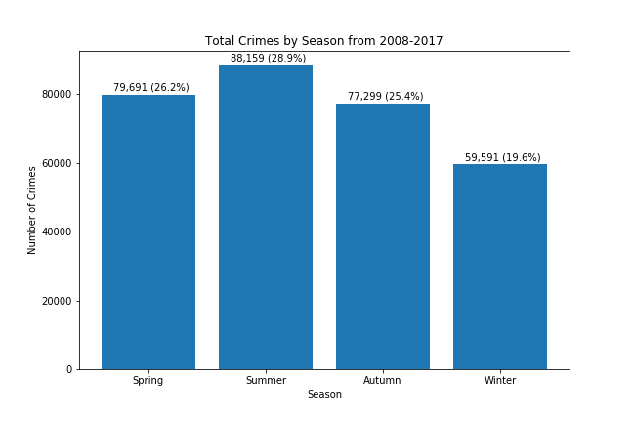
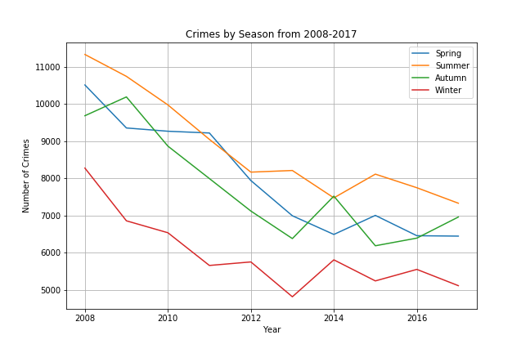
Seasonal Crime

Slide 6
Seasonal Crime

Slide 7
Lunar Crime

Slide 8
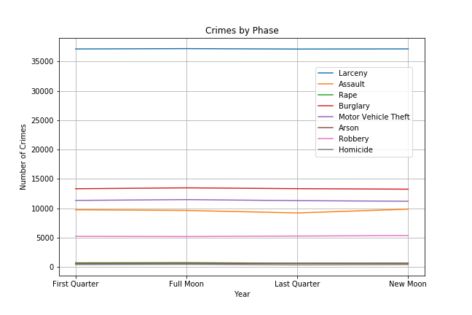
Lunar Crime

Slide 9
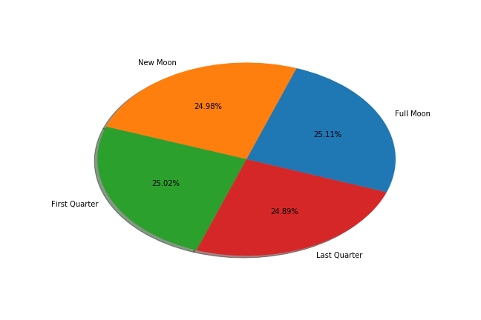
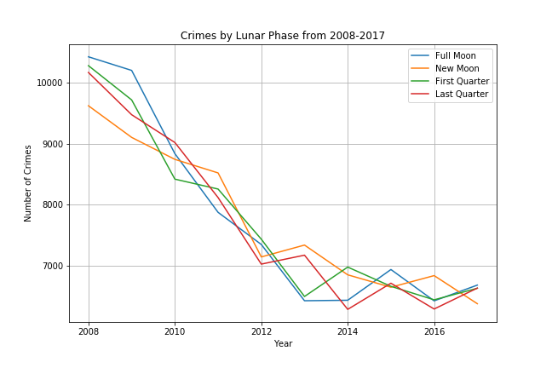
Lunar Crime

Slide 10
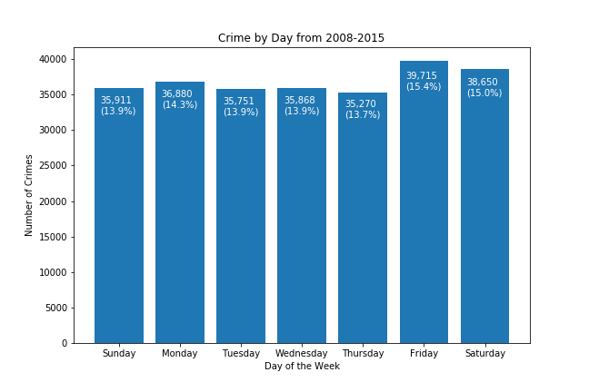
Crime by Day

Slide 11
Crime by Day

Slide 12
Crime by Month

Slide 13
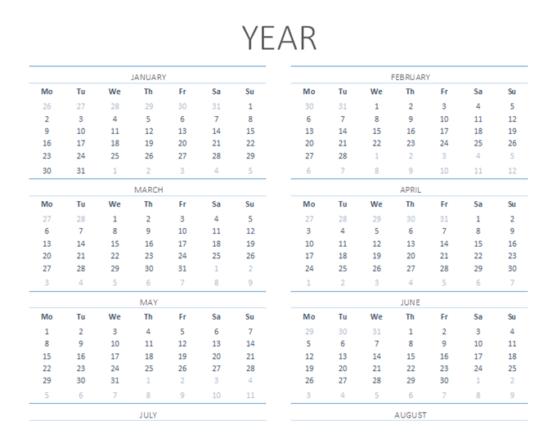
Crime by Month

Slide 14
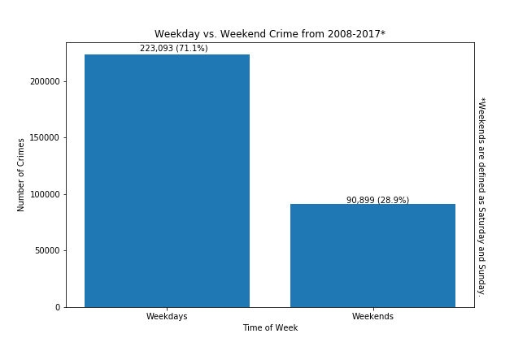
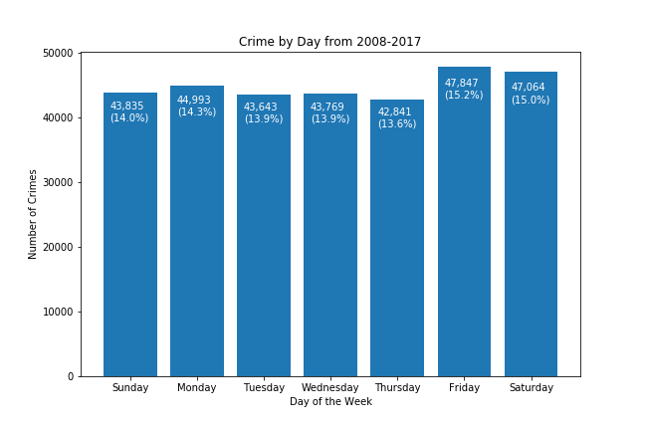
Weekend Crime

Slide 15
Conclusions
There is little correlation between St. Louis crime rates and month. February has the lowest number of crimes, but also has the least amount of days.
Moon phase has little to no correlation on crime rates in St. Louis
There is a slightly higher crime rate on weekends vs weekdays
There is a correlation between seasons. Winter has the lowest amount of crime statistically, while Summer has the highest.

Slide 16
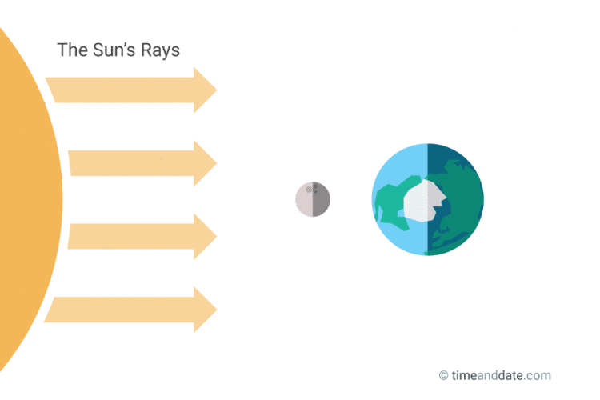
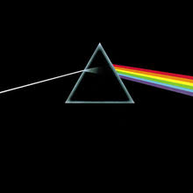
New Moon is the 1st primary phase of the moon and it occurs when the Sun and Moon are aligned, with the Sun and Earth on opposite sides of the Moon. A New Moon cannot normally be seen from Earth since only the dark side of the Moon faces our planet at this time.

Slide 17
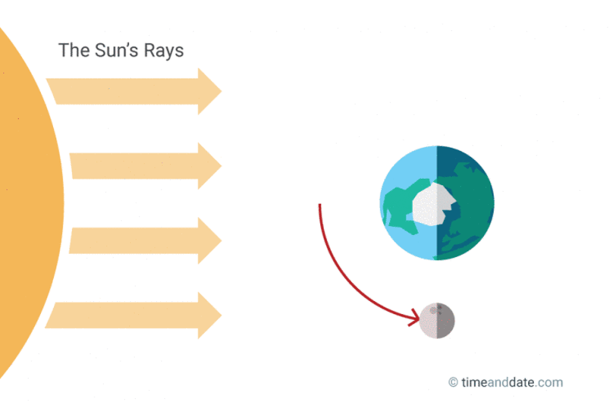
First Quarter Moon is the 2nd primary Moon phase and it is defined as the moment the Moon as reached the 1st quarter of its orbit around the Earth, hence the name. It is also called the Half Moon as we can see exactly 50% of the Moon’s surface illuminated.

Slide 18
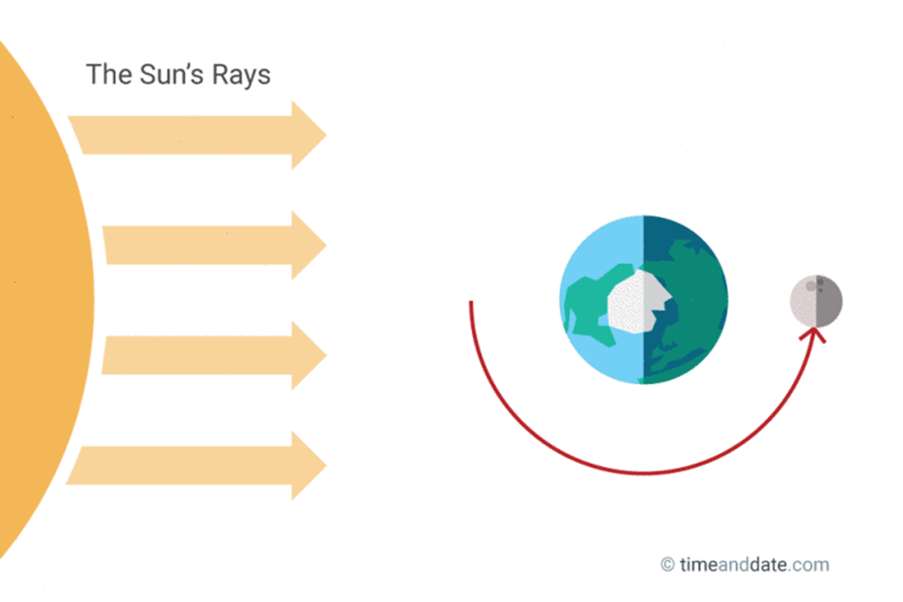

Full Moon appears in the night sky when the Sun and the Moon are aligned on opposite sides of Earth. Full Moon is the brightest phase.

Slide 19
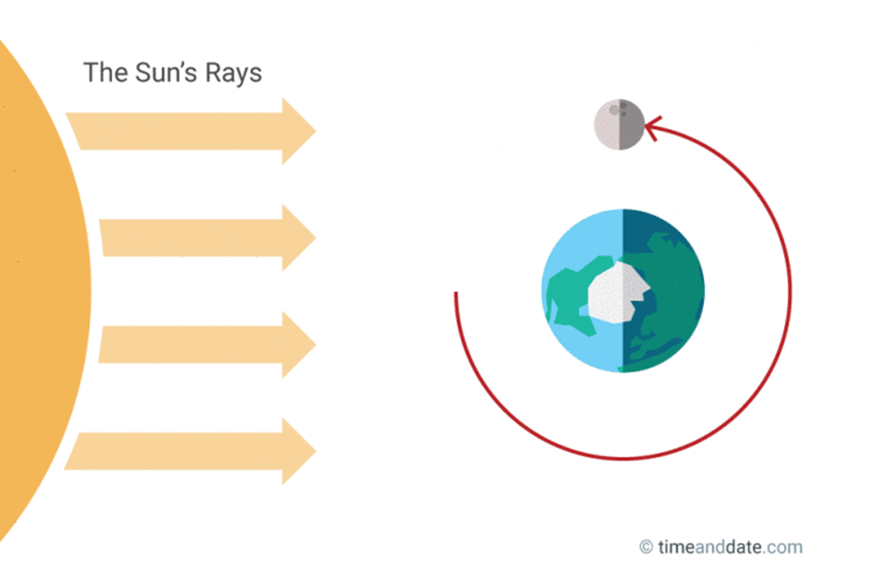
The Last Quarter (aka Third Quarter0occurs the moment the opposite half of the Moon is illuminated compared to the First Quarter Moon.

Slide 20
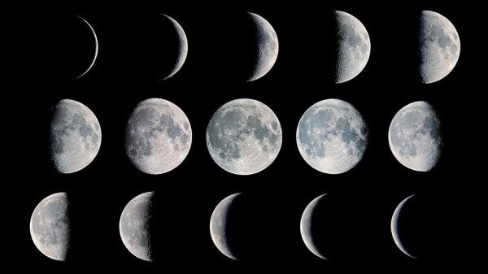
Lunar Phase Descriptive Statistics
 | Sum |  |  |  | Mean |  |  |  | Standard deviation
Phase | First Quarter | Full Moon | Last Quarter | New Moon | First Quarter | Full Moon | Last Quarter | New Moon | First Quarter | Full Moon | Last Quarter | New Moon
Crime
Aggravated Assault | 9760 | 9647 | 9217 | 9862 | 79.349593 | 78.430894 | 74.934959 | 80.178862 | 25.744961 | 23.999003 | 19.402864 | 21.621571
Arson | 725 | 754 | 648 | 690 | 5.894309 | 6.389831 | 5.400000 | 5.750000 | 3.482540 | 3.769046 | 2.769583 | 2.948436
Burglary | 13337 | 13488 | 13349 | 13261 | 108.430894 | 109.658537 | 108.528455 | 107.813008 | 41.289081 | 42.803560 | 39.859451 | 39.092440
Criminal Homicide | 442 | 482 | 392 | 442 | 3.810345 | 4.016667 | 3.379310 | 3.946429 | 2.295227 | 2.473331 | 2.011511 | 2.091765
Forcible Rape | 621 | 592 | 665 | 661 | 5.132231 | 4.892562 | 5.495868 | 5.462810 | 2.949413 | 2.679557 | 3.191457 | 2.935533
Larceny-theft | 37115 | 37175 | 37099 | 37127 | 301.747967 | 302.235772 | 301.617886 | 301.845528 | 75.618932 | 81.520095 | 75.456482 | 70.525432
Motor Vehicle Theft | 11349 | 11486 | 11310 | 11204 | 92.268293 | 93.382114 | 91.951220 | 91.089431 | 40.544465 | 44.256799 | 38.084215 | 39.966176
Robbery | 5235 | 5206 | 5282 | 5369 | 42.560976 | 42.325203 | 42.943089 | 43.650407 | 15.462883 | 14.754547 | 14.741655 | 12.378580

Slide 21
Statistics Fun
Pearson correlation coefficient measures the linear relationship between two datasets.
It requires that each dataset be normally distributed.
Pearson correlation varies between -1 and +0 with 0 implying no correlation.
Correlations of -1 or +1 imply an exact linear relationship.
Positive correlations imply that as x increases, so does y.
Negative correlations imply that as x increases, y decreases.
How do I know if my data is normally distributed?

Slide 22
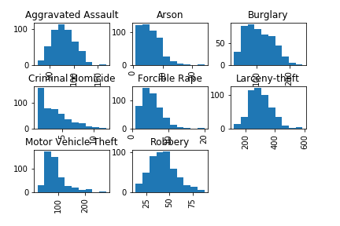
Overall Distribution by Crime – Snapshot histogram

Slide 23
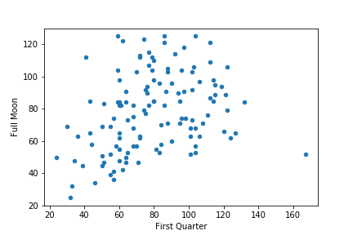
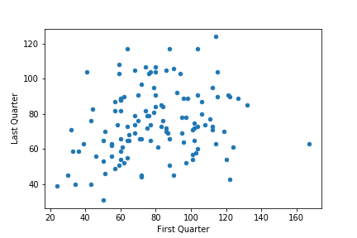
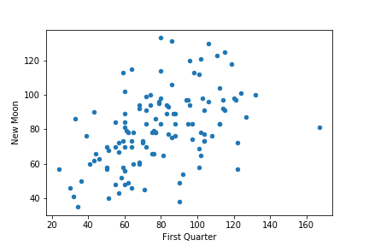
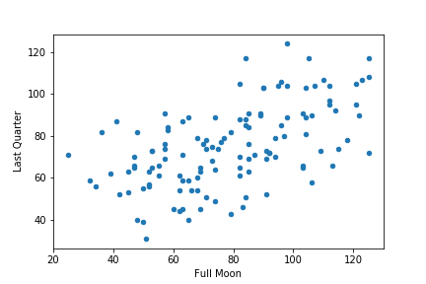
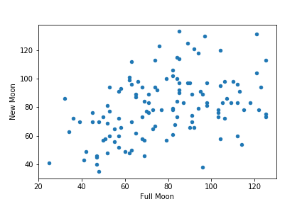
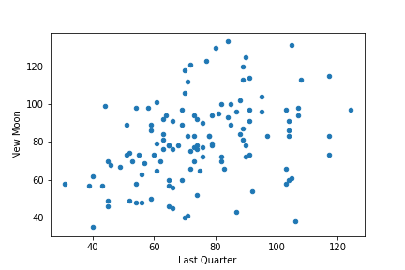
Aggravated Assaults Scatter Plots Comparing Each of the Moon Phases

Slide 24
Aggravated Assaults Scatter Plots .00 - .19 Very Weak with PearsonR listed .20 - .39 Weak .40 - .59 Moderate .60 - .79 Strong .80 - .1 Very Strong
R = .316
R = .227
R = .465
R = . 558
R = .413
R = .366

